Slide 1
Insights on Online Violence Against Women in Tanzania

Slide 2
Part 1: Women's Digital Inclusion Ecosytem- Who is doing what?
Contents of the Report
Part 2: Policy - Emerging Trends and National Efforts to look forward to.
Part 3:Safe Online Spaces for Women & Insights from #MitandaoNaSisi Advocacy Campaign
Part 4: Recommendations

Slide 3
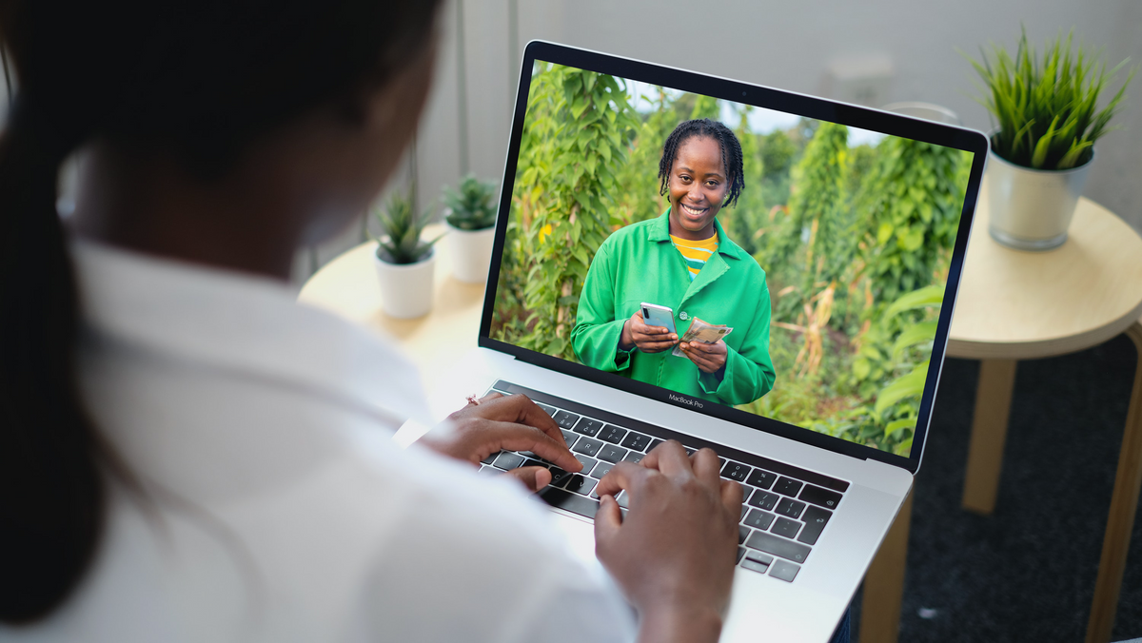
WHERE ARE WE?
HOW MANY WOMEN HAVE INTERNET ACCESS IN TANZANIA?
"Just over 41% of Tanzania’s population (25 million people) currently use mobile
technology, 1 while a fifth (12.3 million people) use mobile internet.
Both are slightly below the average adoption levels seen in Sub-Saharan Africa.
Large sections of the population in Tanzania – especially in rural and low-income areas
are therefore unable to connect.
Around a third of those in urban areas are currently connected to mobile internet
compared to 13% in rural areas" - GSMA Mobile Gender Report 2019

Slide 4
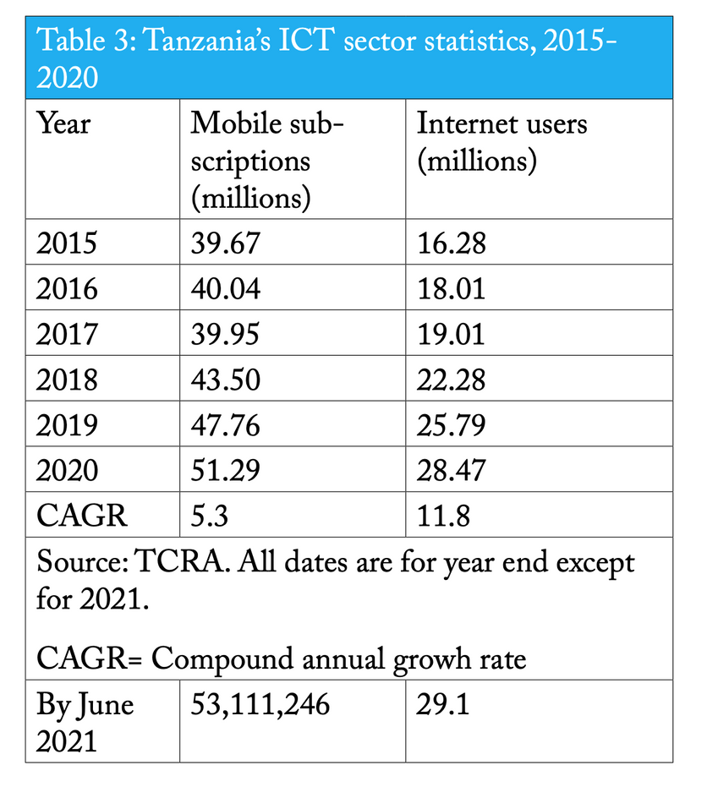
WHAT DOES THE NATIONAL DATA SAY?
FACT - THERE IS NO DISAGGREGATED DATA SHOWING HOW MANY OUT OF THE 28 mil + ARE WOMEN
Upcoming Population Survey might include household data on internet usage and mobile device ownership - to be confirmed.
SOURCE - TCRA

Slide 5
IS
THE
CURRENT
ICT
POLICY
GENDER
INCLUSIVE?
?

Slide 6
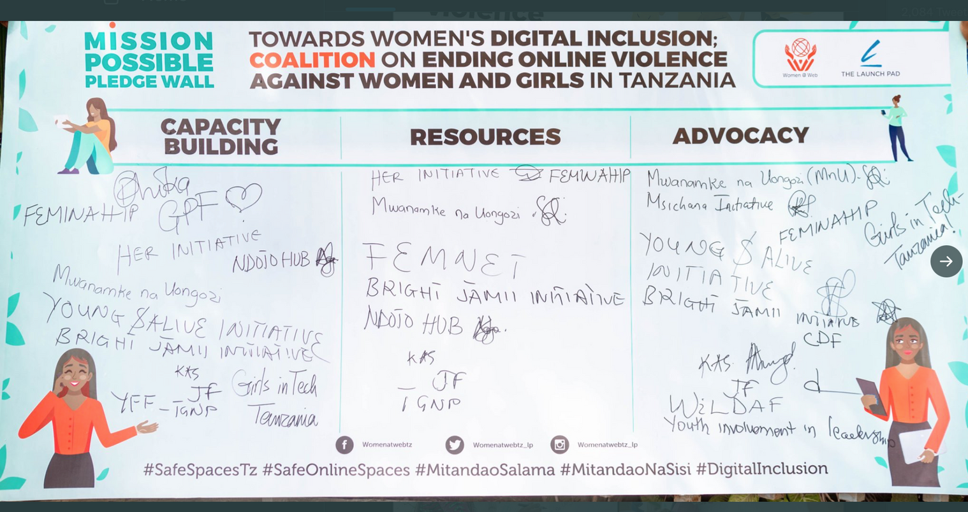
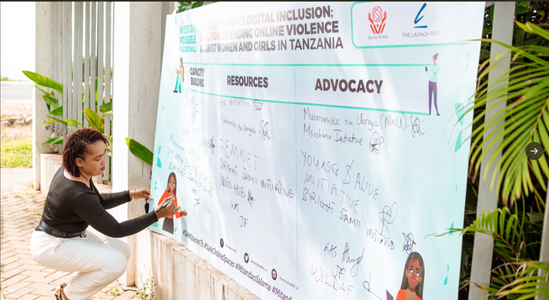
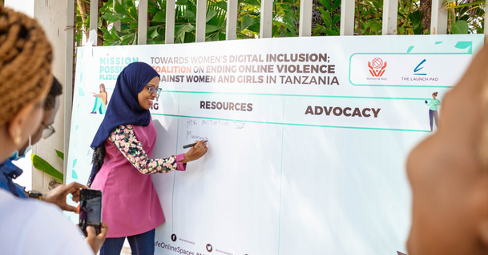
WHO IS DOING WHAT TOWARDS BRIDGING THE DIGITAL GENDER DIVIDE IN TANZANIA (CSOs)
Existing Programs Focus on:
Co-creation of Solutions towards women's digital inclusion
Advocacy for a Gender Responsive ICT Policy
Capacity Building/Digital Skills Programs
Digital Resilience Programs
Digital Economy Entry Programs for Women
Advocacy on Safe Online Spaces
Cyber Crime Law Review to include OGBV section
Digital Storytelling for Women

Slide 7
Tanzania Women Chamber
of Commerce - GIZ
Digitrade Project - US Embassy
Dare to Shift- DOT Tanzania
Her Initiative
The Launchpad Tanzania
Digital Economy
Entry Programs
Lobbying
&
Advocacy
The Launchpad Tanzania
WILDAF
TAMWA
TGNP
Jamii Forums
Apps & Girls
TAMWA
WILDAF
She Found
Buni Hub
Ndoto Hub
TGNP
DOT Tanzania
Jamii Forums
Friedrich Ebert Stiftung
Girl Effect
Bright Jamii
Mwanamke na Uongozi
Tanzania Women's Digital Inclusion ECOSYSTEM
The Launchpad Tanzania
Panda Digital - Her Initiative
Ndoto Hub
CAPACITY
BUILDING
Online Resources
WILDAF
TAWLA
The Launchpad Tanzania
Support
Tanzania Communication RegulatoryAuthority
UCSAF
ICT Commission
Authorities/Regulators
Commisions

Slide 8
EMERGING TRENDS & OPPORTUNITIES FOR WOMEN AND DIGITALISATION
Women Entrepreneurs - low hanging fruit - offline businesses to online
Digital Content Creation & Online Freelancing
Major shift from offline to online businesses - with new opportunities emerging like online grocery shopping , online fashion and accessories shopping, and catering - Source COVID 19 TZ Realities Survey for SMEs and Micro Enterprises
77% of 100 women surveyed by The Launchpad said they use digital platforms to advertise and promote their businesses - Source LP Digital Short Survey on Online Participation of Women
Digital Influencing and Marketing
Observed trend on Youtube, Instagram Reels and TikTok
Freelancing and Online Gigs trending topic and point of discussion for female users age 25-30
Observed trend on Twitter, Instagram and Tiktok for female users with followers over 5000+

Slide 9
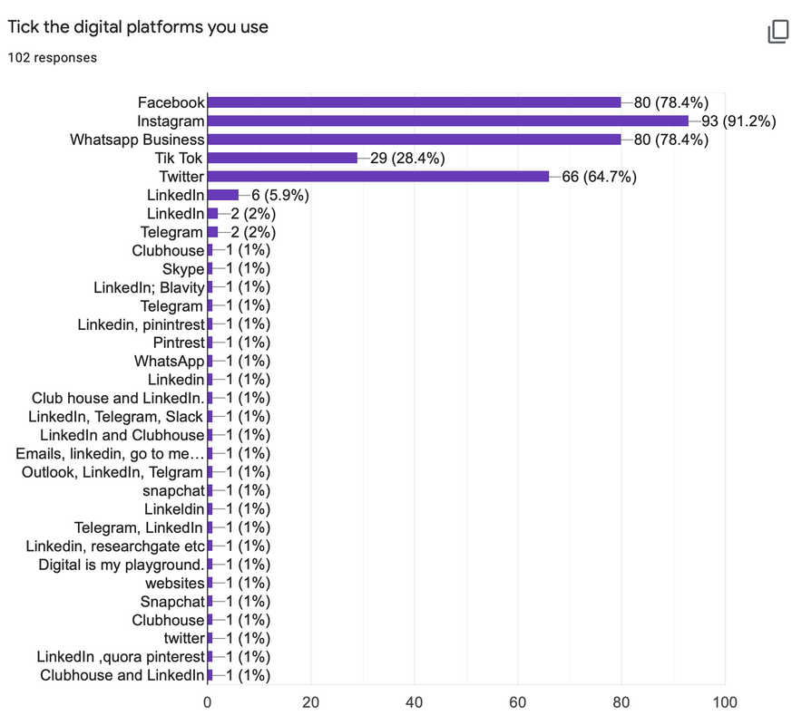
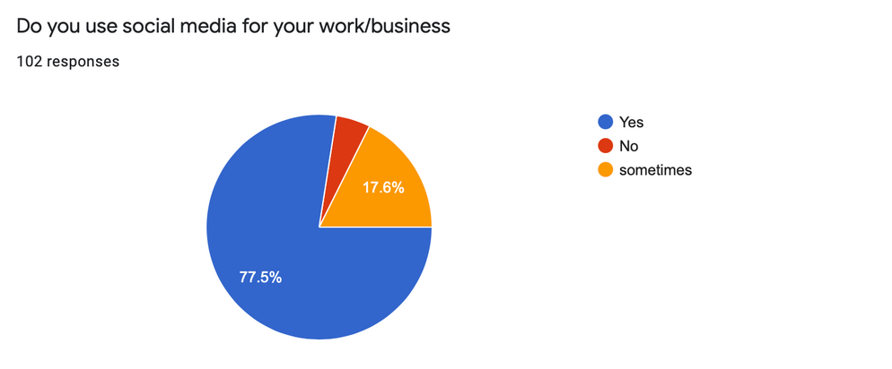
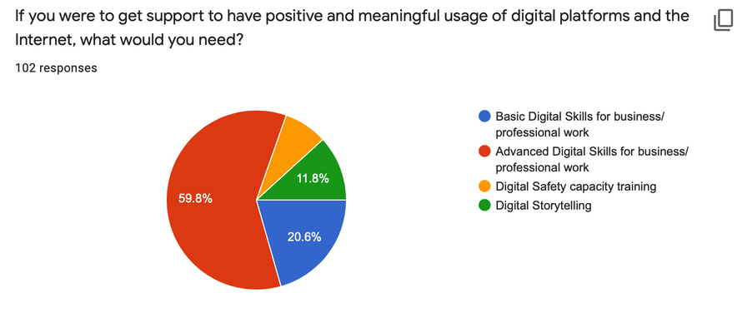
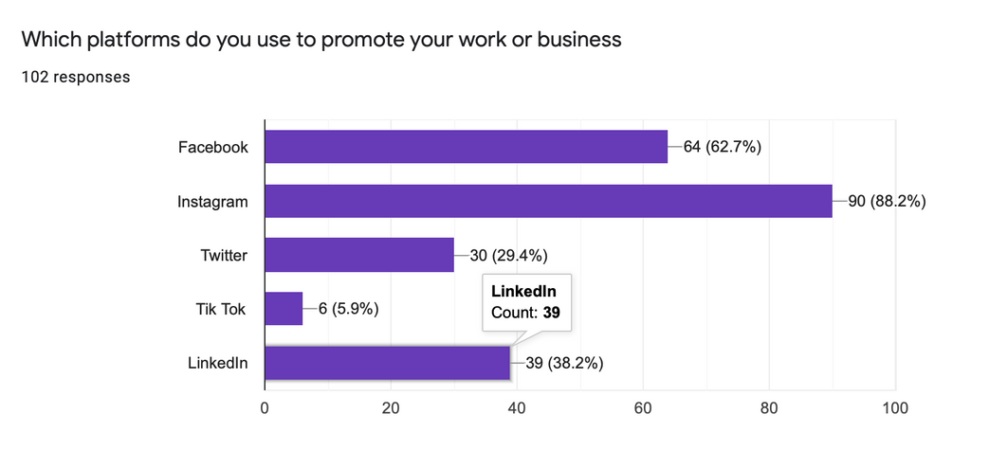
EMERGING TRENDS & OPPORTUNITIES FOR WOMEN AND DIGITALISATION

Slide 10
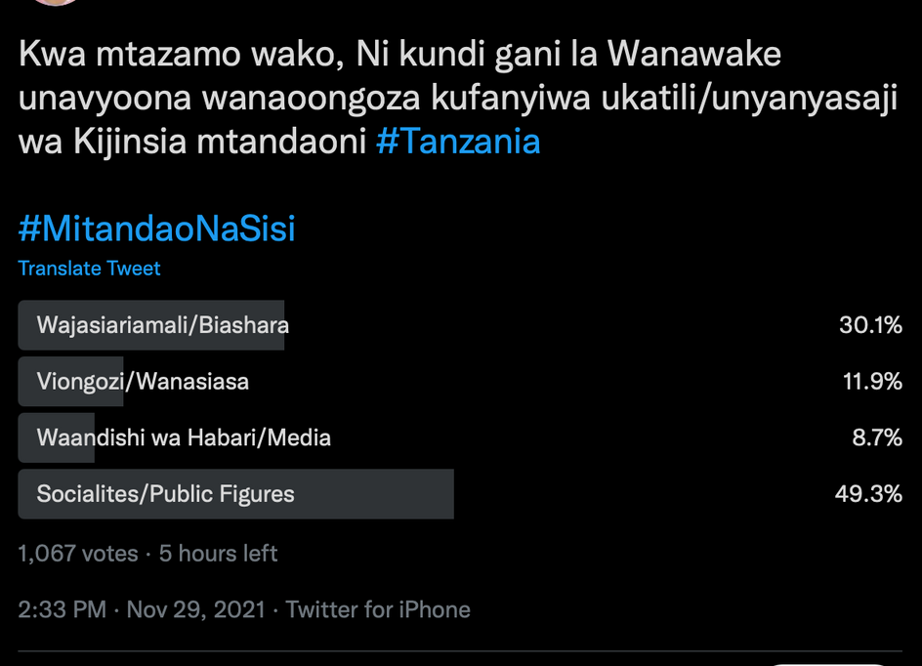
SAFE ONLINE SPACES
#MITANDAONASISI

Slide 11
LP' DIGITAL'S APPROACH ON OVAW
*CAPACITY BUILDING
Digital Literacy & Digital Safety
*ADVOCACY & LOBBYING
Awareness Campaign
Policy & Law Reforms
Mindset Change & Sensitization for Enforcers
*REPORTING TOOLS FOR ESCALATION OF CASES
-Whatsapp Helpline + Google Form
*LEGAL AID FOR FILING OF CASES WITH TANPOL IN PARTNERSHIP WITH WILDAF
*MENTAL WELLNESS/COUNSELLING
PREVENTIVE
RESPONSE

Slide 12
What does the Cyber Crime Law say...
-no section on OGBV
-In the case of NCII
the woman is criminalized first

Slide 13
WHAT DOES THE EVIDENCE SAY?
Underreporting of cases
due to few convictions on abusers
TANPOL General Attitude

Slide 14
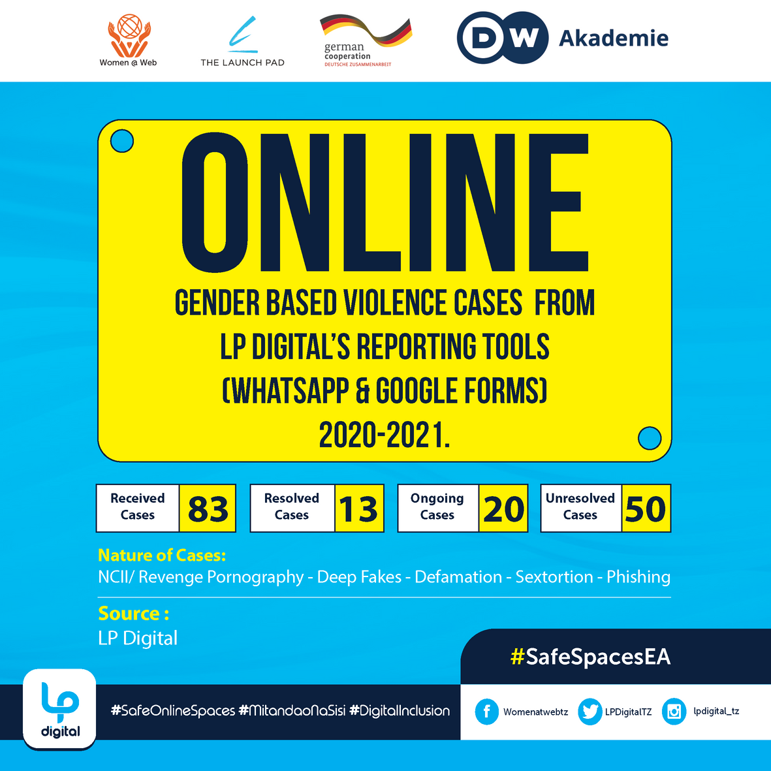
WHAT DOES THE EVIDENCE SAY?
Victims are more comfortable with an intermediary between them and the authorities - outside agency

Slide 15
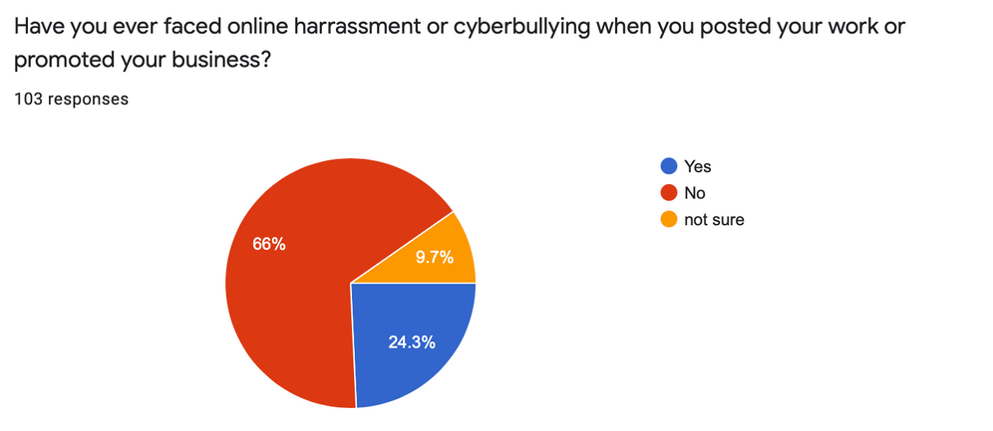
RESULTS FROM OUR SHORT SURVEY ON HOW WOMEN USE DIGITAL PLATFORMS FOR BUSINESS AND WORK AND THEIR EXPERIENCE ON ONLINE HARRASMENT
ACTIONS TAKEN FROM BOTH MONITORED ACCOUNTS AND REPORTED CASES
Blocked Abuser Account
Reported to Online Platform
Took a break from online platforms
Reduced online presence/engagement
Ceased using that online platform
CONCERNS
WHAT DO THEY NEED
fears around
privacy, safety and security
unaware of reporting processes
Reputation Damage
Mental Wellness breakdown
targeted/specific design & access
of safety tools
Improve systems for reporting abuse/
platform accountability
Pyscho Social Safety Support

Slide 16
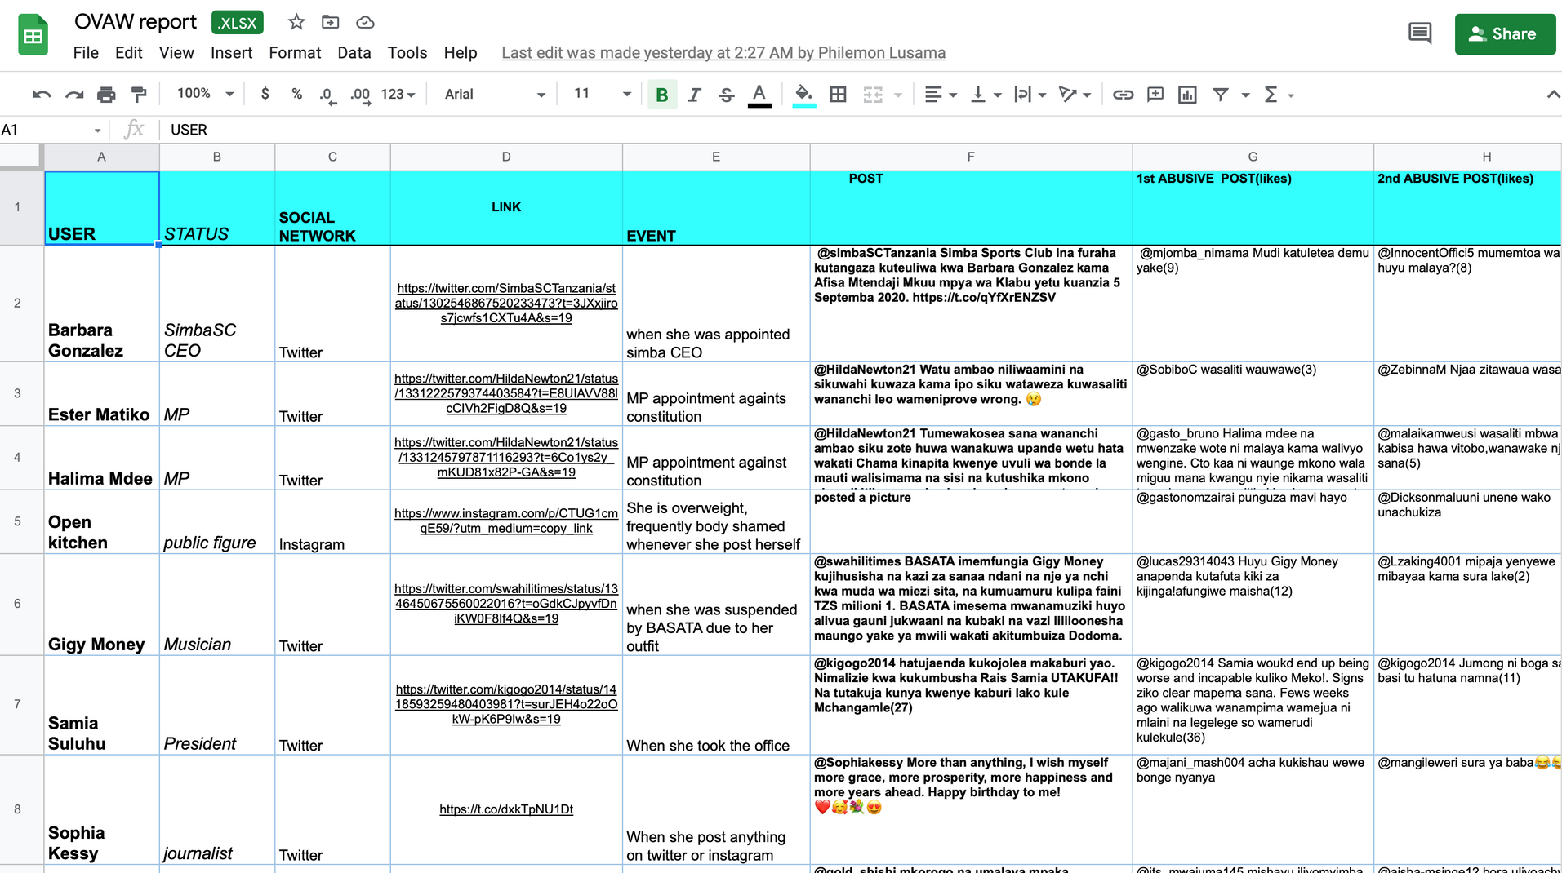
MONITORED ACCOUNTS OF VOCAL & ACTIVE WOMEN DIGITAL USERS IN TANZANIA (UPDATED MONTHLY) https://docs.google.com/spreadsheets/d/1O8RdfUEKmuR0tSIfQQsqm7KKjaF70fr6/edit?usp=sharing&ouid=108103790168063447876&rtpof=true&sd=true

Slide 17
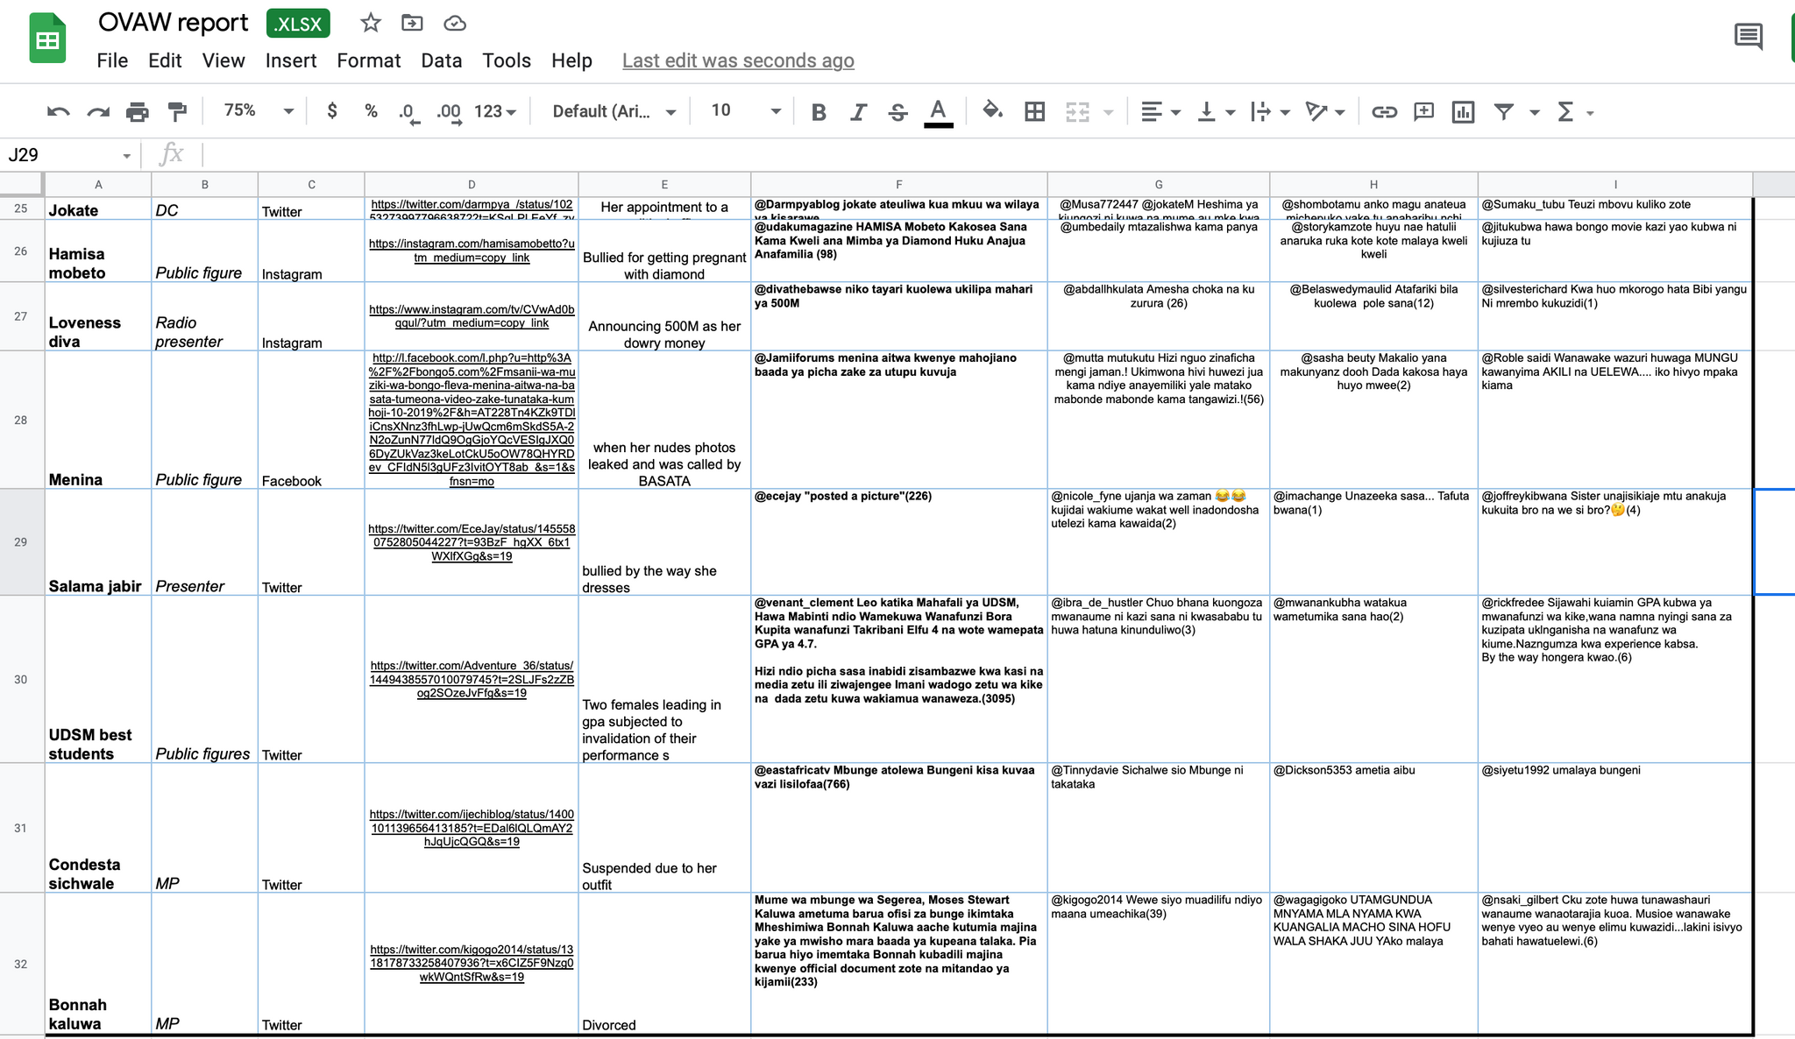
MONITORED ACCOUNTS OF VOCAL & ACTIVE WOMEN DIGITAL USERS IN TANZANIA - UPDATED MONTHLY

Slide 18
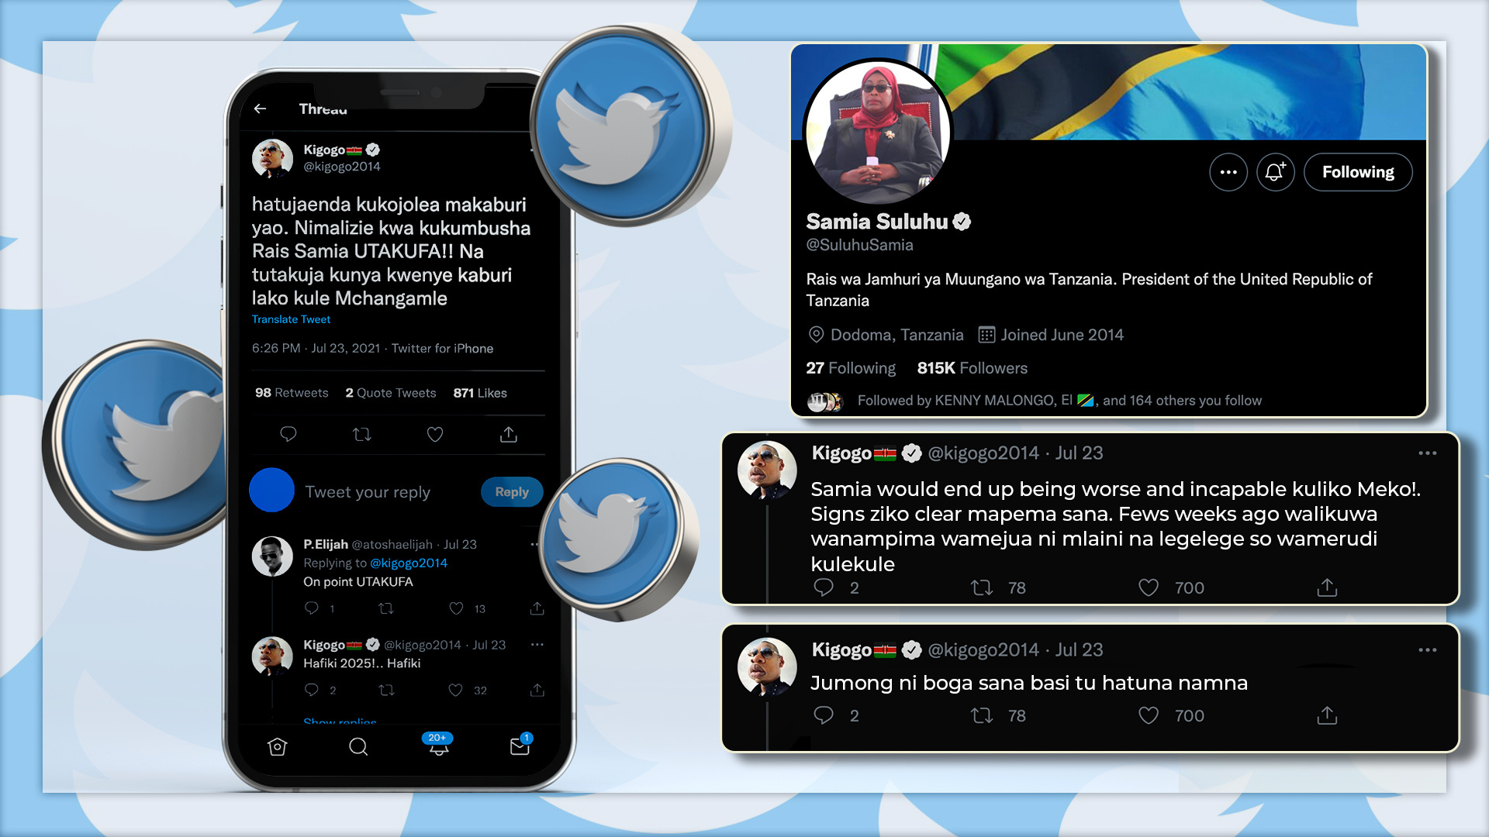
SPOTLIGHT OGBV STORY

Slide 19
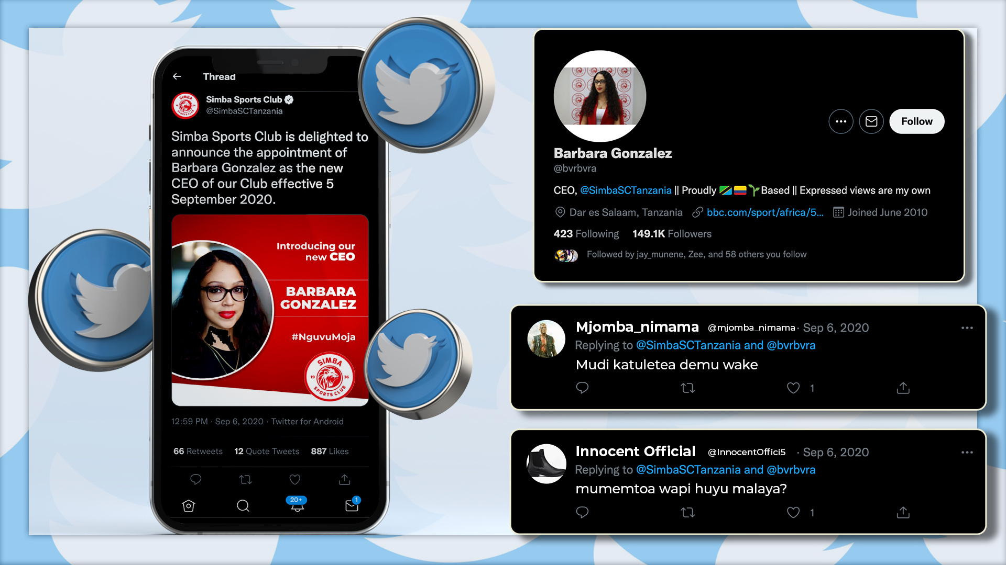
SPOTLIGHT OGBV STORY

Slide 20
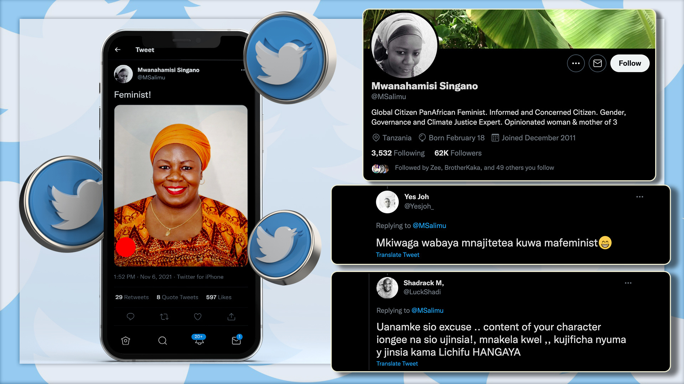
SPOTLIGHT OGBV STORY

Slide 21
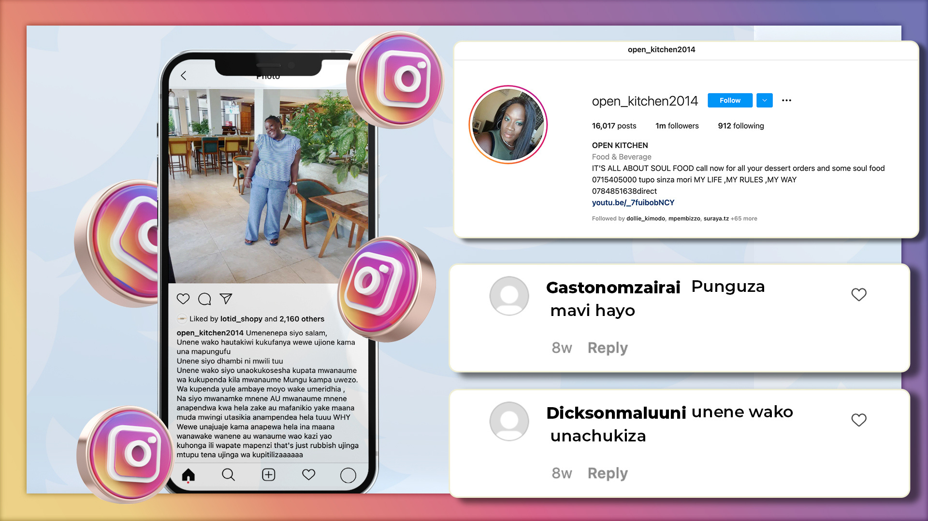
SPOTLIGHT OGBV STORY

Slide 22
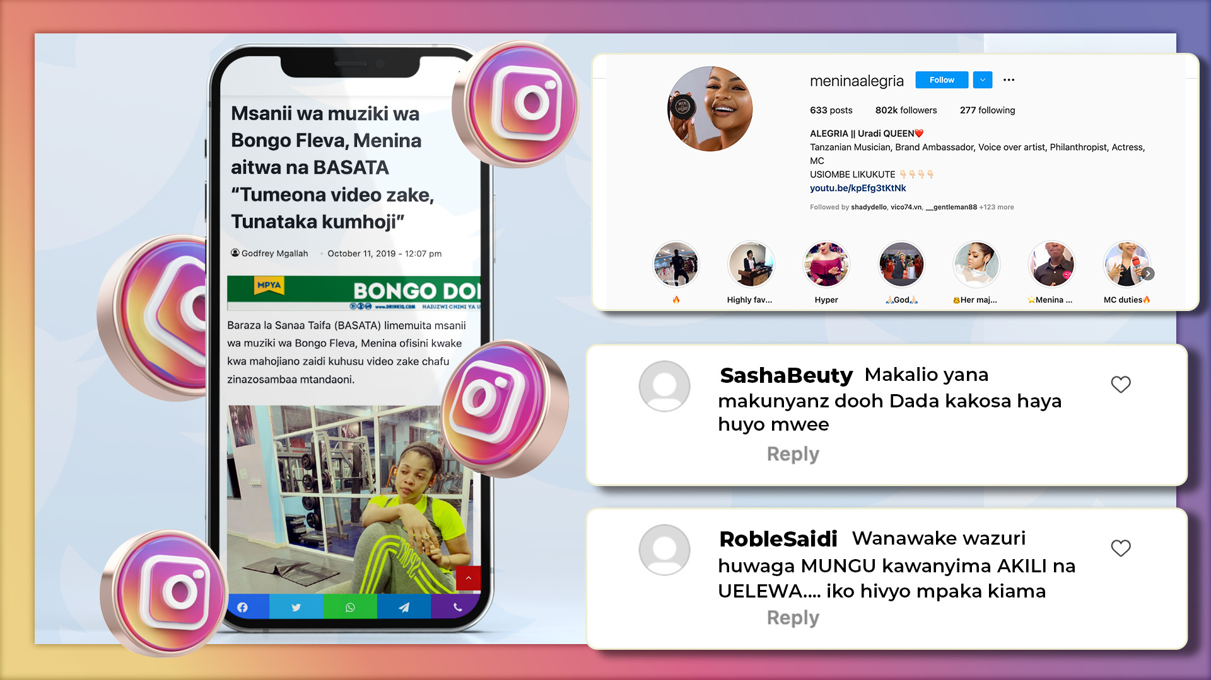
SPOTLIGHT OGBV STORY

Slide 23
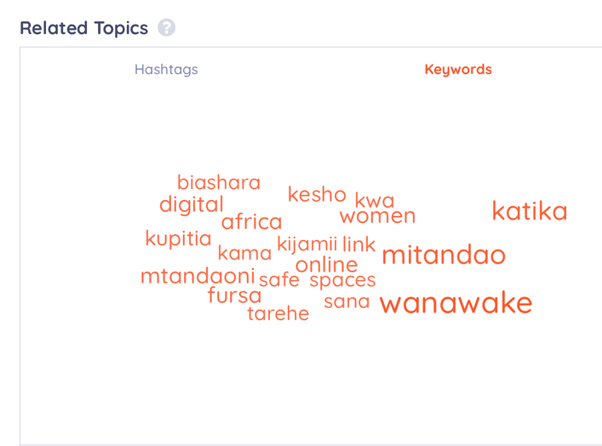
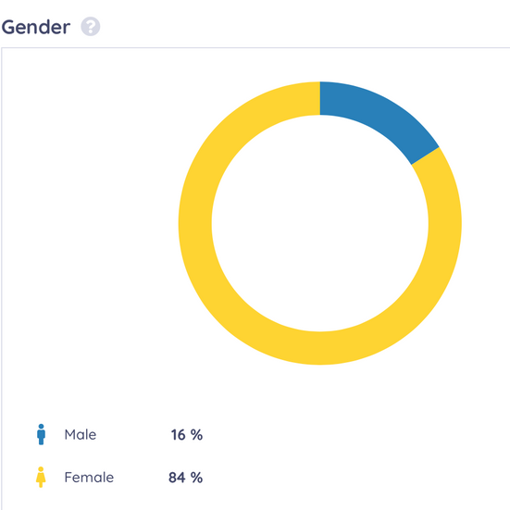
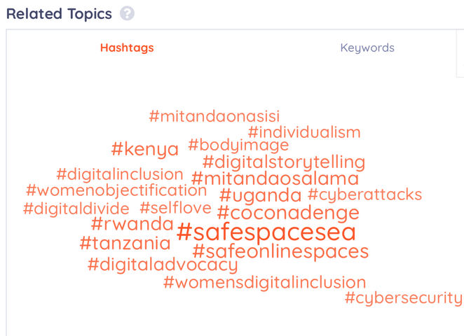
#MITANDAONASISI ADVOCACY CAMPAIGN
METRICS FROM OCT-NOV 2021
Platforms Used
Online :
Youtube
Twitter, Google Podcasts, Apple Podcasts, Website, Instagram, Facebook, TikTok
Offline
Dizzim TV on Star Times & Azam Decoders
EFM & ETV

Slide 24
RECOMMENDATIONS
Capacity Building
Digital Literacy
Digital Citizenship
Digital Safety
More Recognition and Amplification on Online Gender Based Violence through law and policy
More transparency on conviction of OVAW cases
More awareness on the Cybercrime Law and Policy specifically OVAW
Joint efforts in the Ecosystem to create pipeline support systems i.e the Coalition and partnership with WILDAF
More efforts on changing the narrative and social norms hindering women's online participation OVAW
Political will in addressing affordability of devices and data
More targeted inverventions focusing on the diverse groups of women and their needs through co-creation and co-designing of solutions
Lobbying on Gender Responsive ICT Policy
Lobbying on Cyber Crime Law to have OGBV Section
Advocacy on Stakeholders Accountability towards safe online spaces accross the piece
Advocacy & Awareness
Access to Resources and Justice on OGBV
Access to pyscho social safety and legal support on OGBV cases
Industry Based Approach on pushing for safe online spaces

Slide 25
This report is prepared by LP Digital, an arm of The Launchpad Tanzania for the Women at Web Initiative
Which is Supported by

